Slide 1
COMP9414 Tutorial
Week 2

Slide 2

Participation mark
Remain in the tutorial for a reasonable amount of time
Total time so its okay if you disconnect a few times
Complete the provided form
Sent after class, due prior to the next tutorial
Submit however many times you want, I’ll take the latest one

Slide 3
News
Assignment will be released Monday, Week 3
June 15th
Explanation during consultation time
Make sure you attend
Exam will be multiple-choice

Slide 4
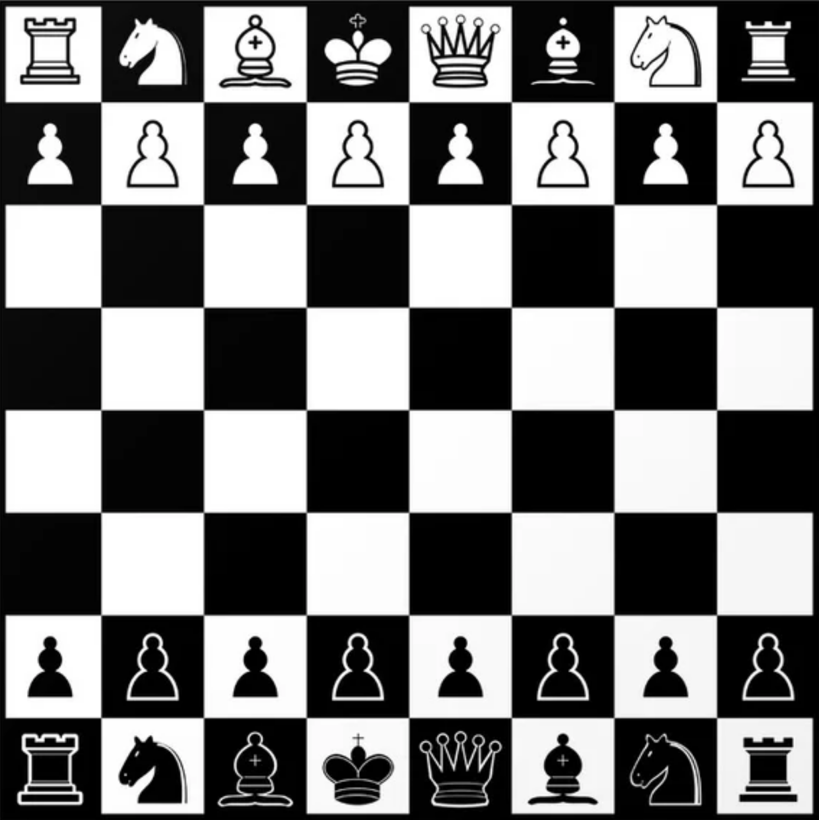
Definitions – Initial state
Beginning state where the search algorithm would begin
All pieces are in their initial positions
Can start the state search from here to determine a sequence of moves to win

Slide 5
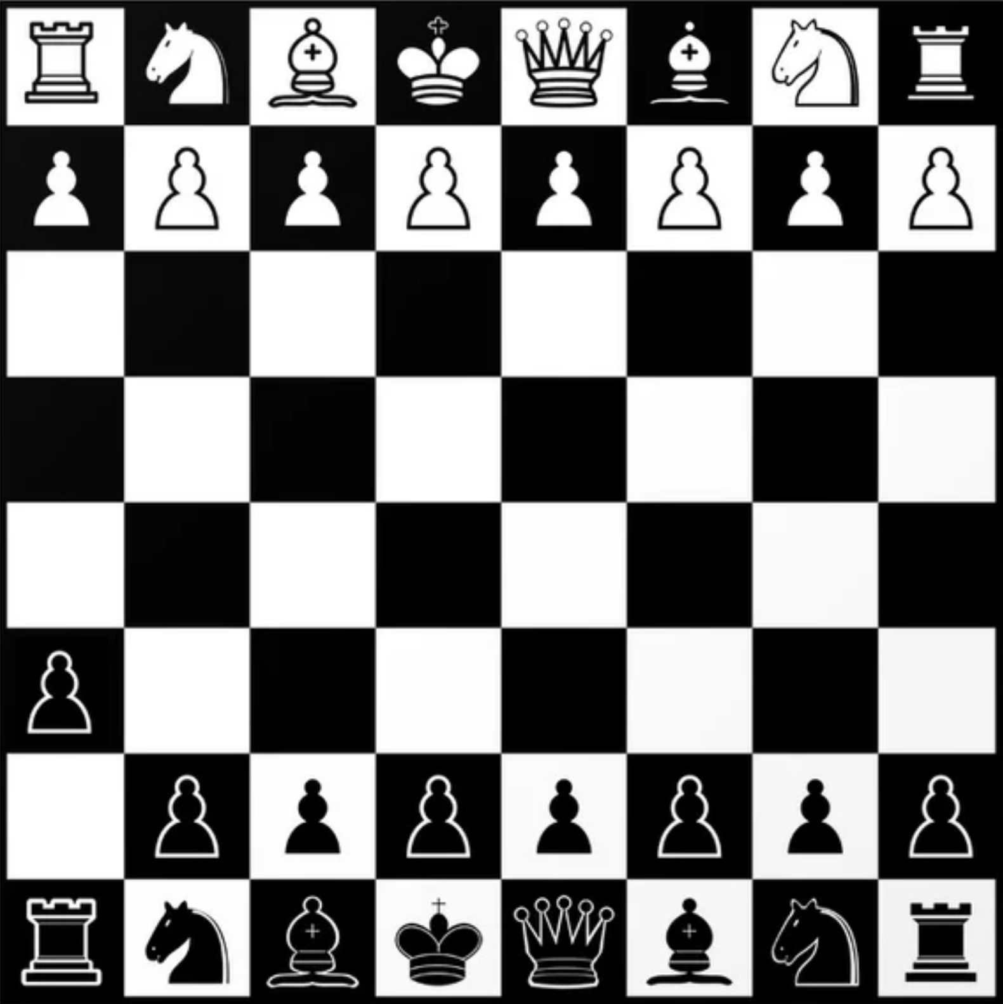
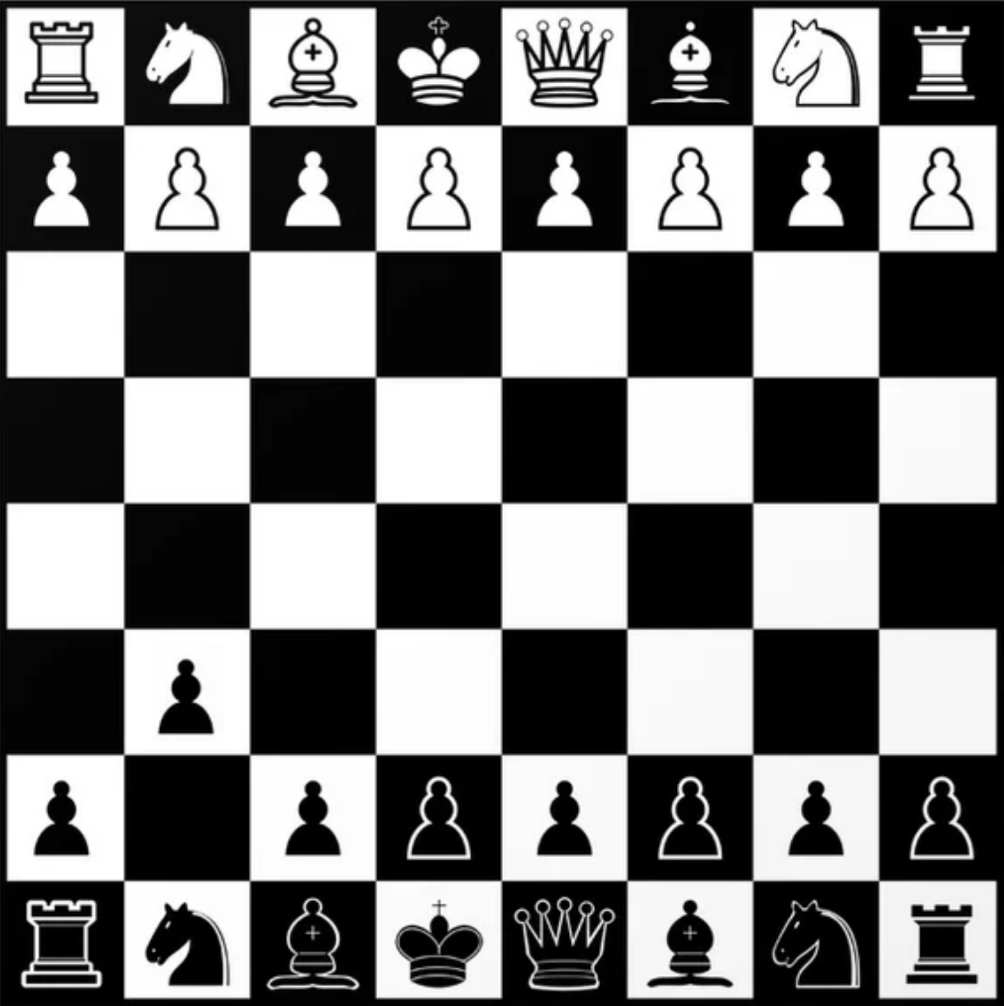
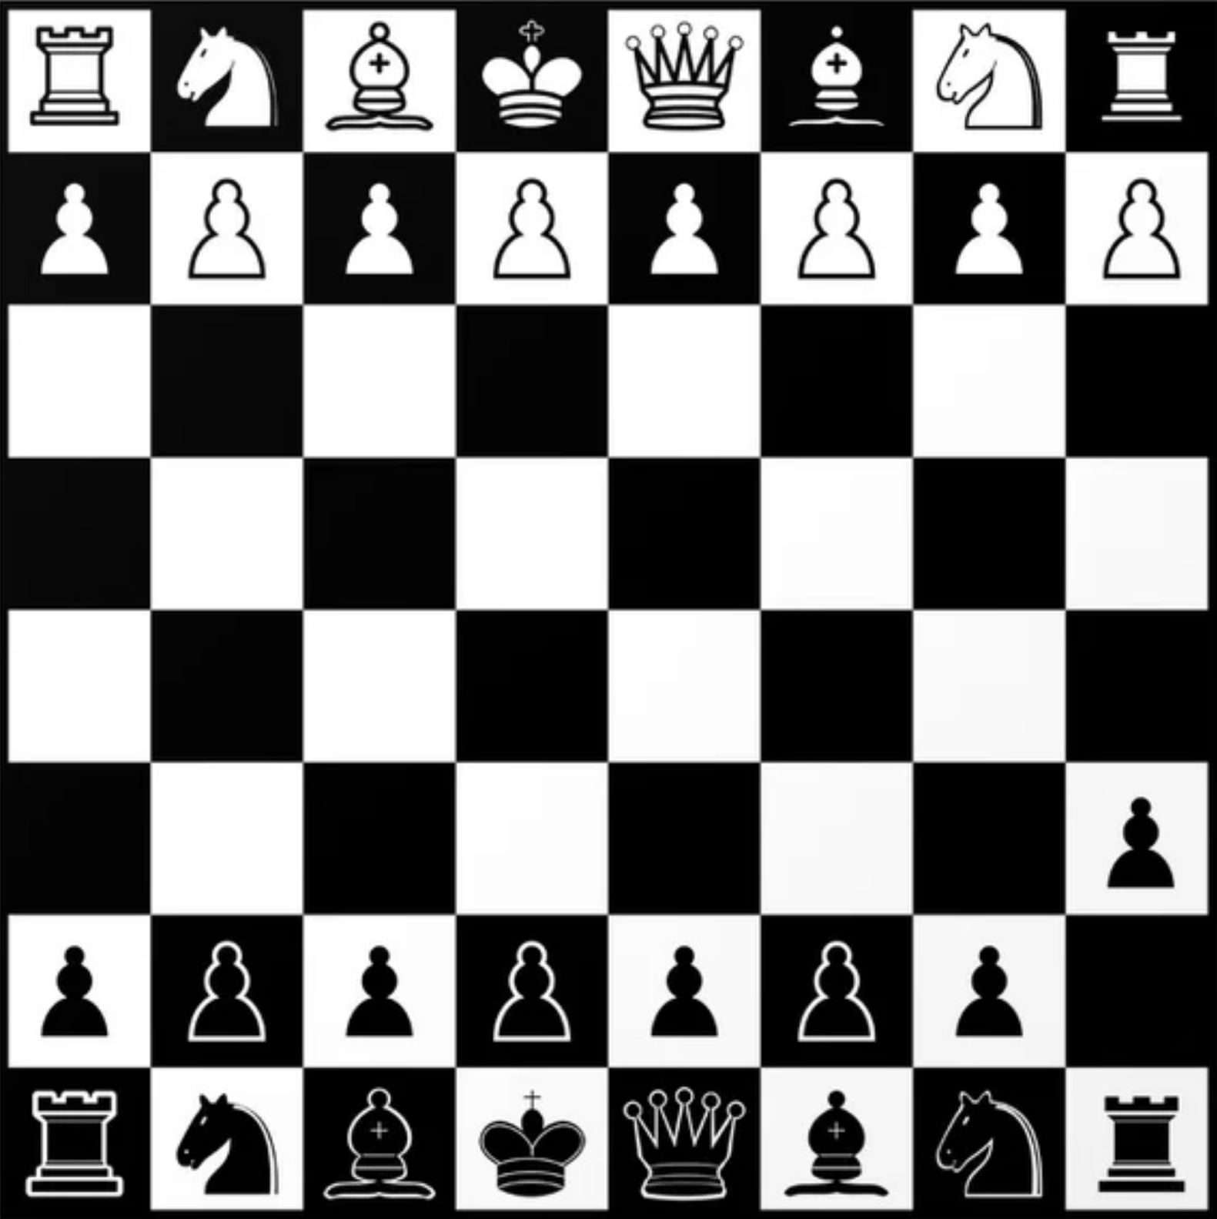
Definitions – State space
Set of states reachable from the current position
Possible states that can be expanded from the current position
Potential moves that can be made
Initial state
State space
,
,
Operation

Slide 6
Definitions – Transitions
Based on operations or actions that an agent can perform
Successor function determines state space based on this operation
Successor Function
Operations
S (current_state, operation) = new_state
Moving a particular piece
Achieving check
Removing an opponent piece
Achieving check-mate
S
Move pawn
A2 → A3
=
,

Slide 7
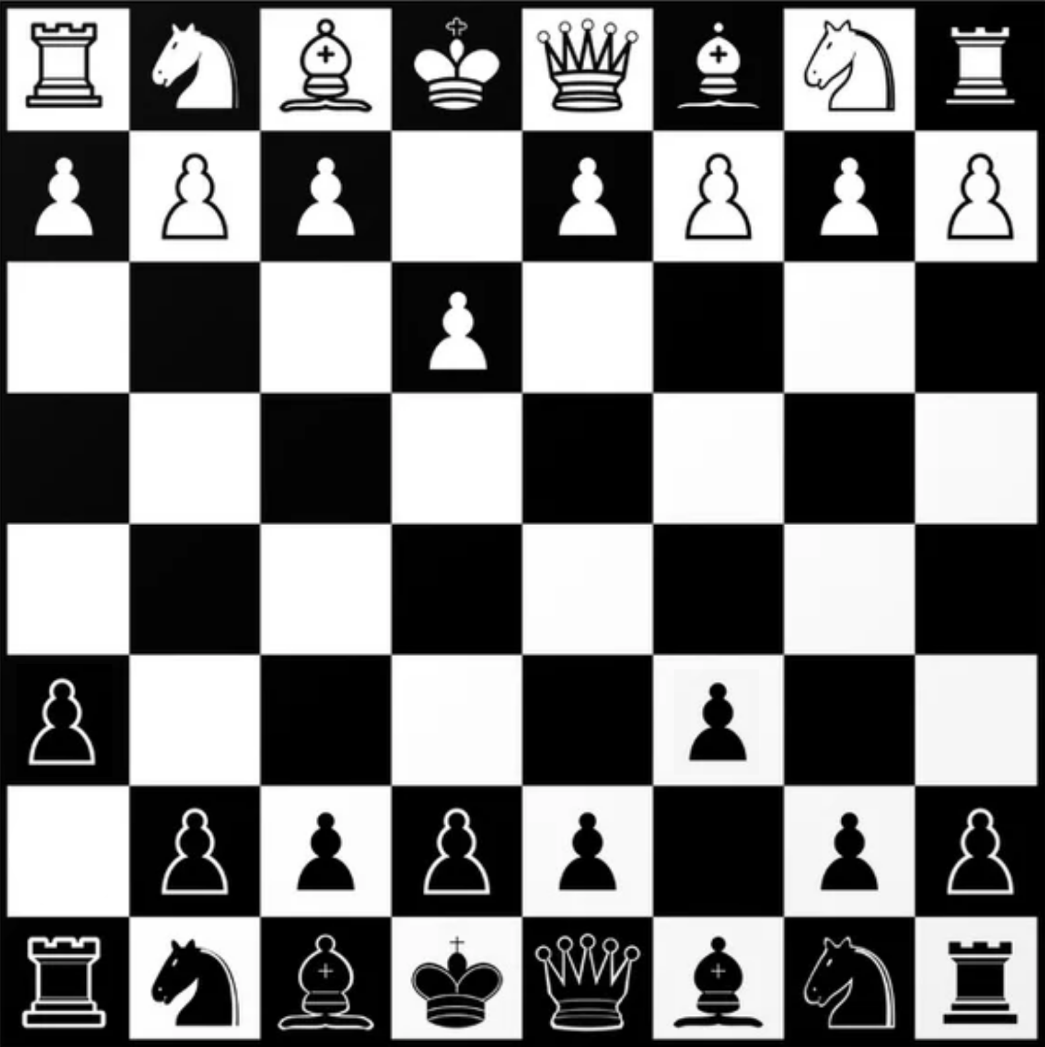
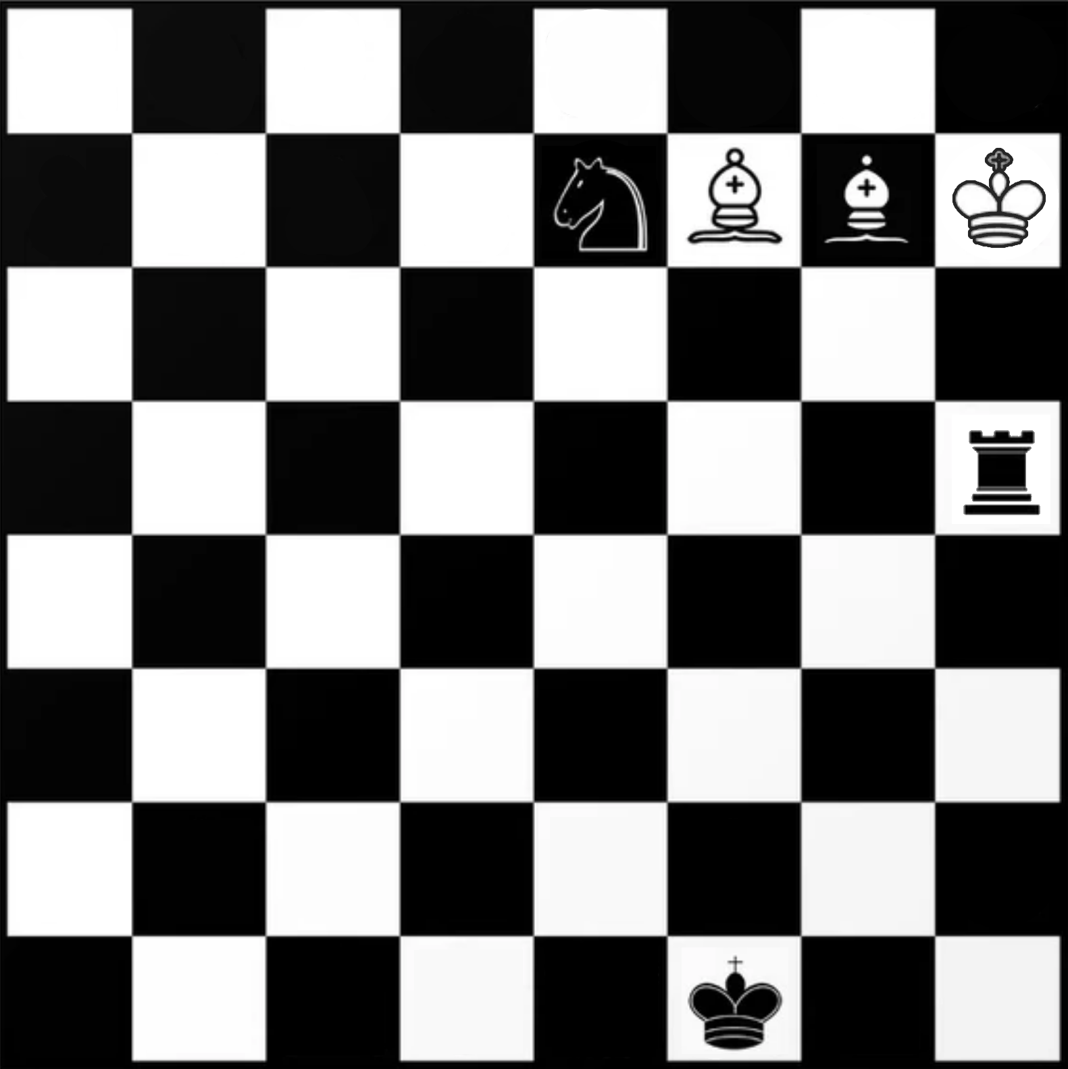
Definitions – Traversal
Find a path from initial state to goal state
Path cost should be minimised
Path cost
Initial state
Goal state
Step cost
Step cost

Slide 8
Definitions
Initial state
Starting state at the beginning of the search algorithm
State space
Set of states reachable from the current state
Transition
Based on operations or actions that an agent can perform
Successor function determines state space based on this operation

Slide 9
Definitions
Goal state
State that needs to be reached
Step cost
Cost required to transition from one state to another in the immediate state space
Path cost
Cost required to transition from one state to another along some path
Can have multiple states along the path

Slide 10
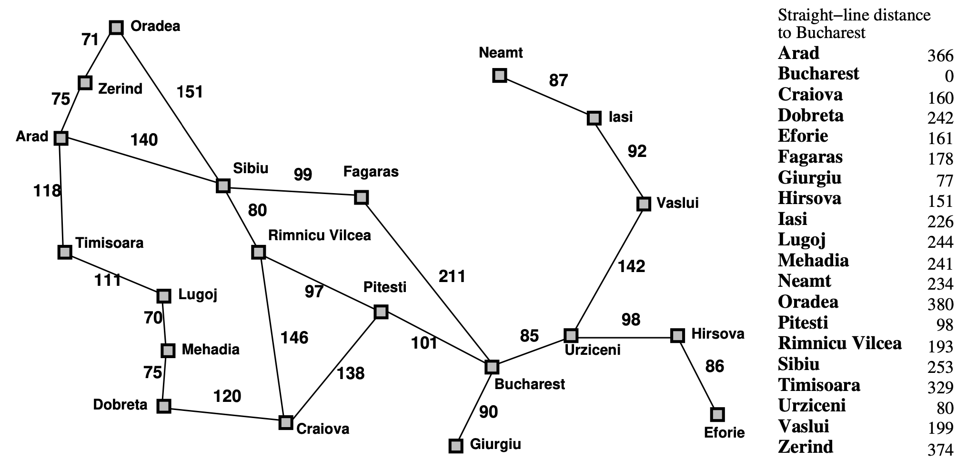
Question 1 – Arad → Bucharest
Arad
Bucharest

Slide 11
Question 1 – Depth-first Search
1
Time Complexity
O(bm)
Space Complexity
O(b^{m})
Not Complete
2
3
4
Not Optimal
Implementation
Datatype
Stack
List
5
6
7
8
Visited list (Generation)
List
Connections
Dictionary
Stack
1
2
3
6
7

Slide 12
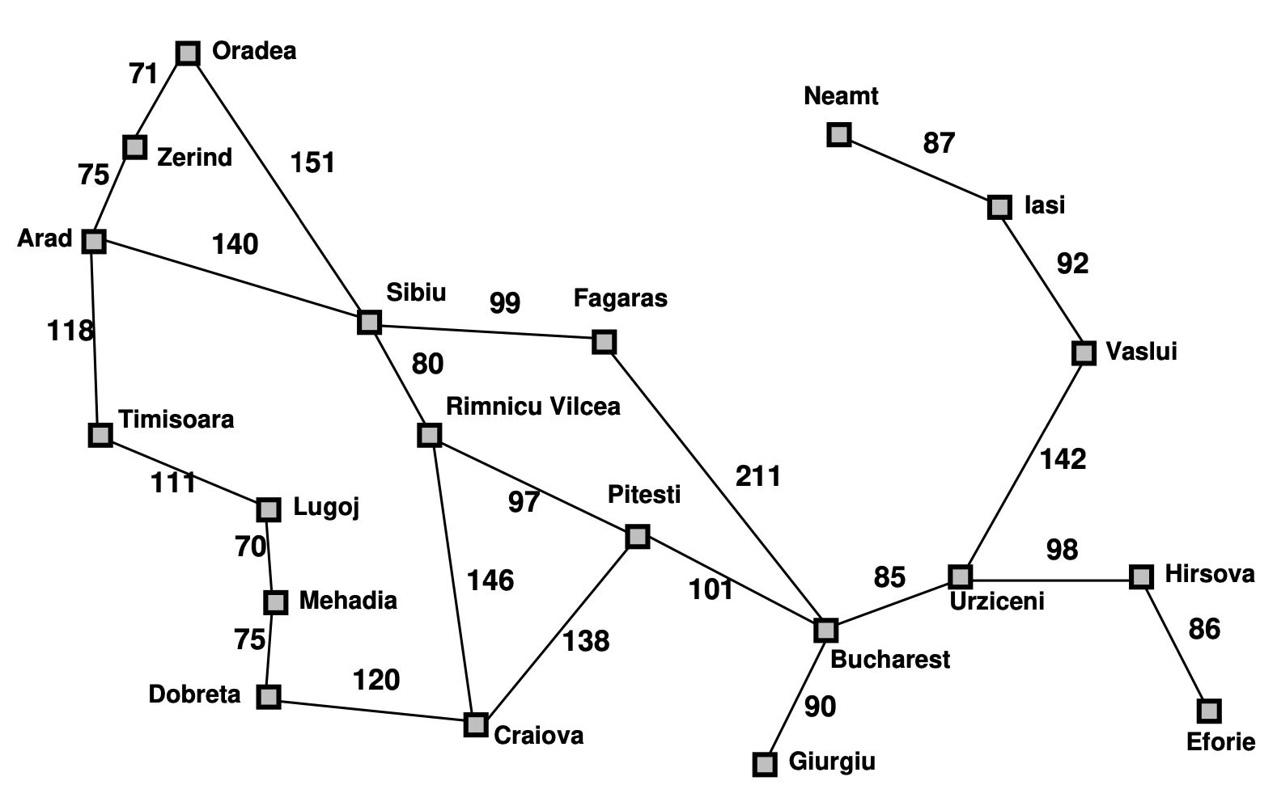
Question 1 – Depth-first Search
Visited list
Connections
Alphabetical order
A
Z
T
/ : A
A : Z
A : T
A : S
S
R
F
S : R
S : F
F : B
:
B
:
:
:
:
Selected Path
A
S
F
B
Stack
A
Z
T
S
R
F
B

Slide 13
Question 1 – Iterative-Deepening Search
Depth = 0
1
Time Complexity
O(b^{d})
Space Complexity
O(d)
Complete
2
3
4
Optimal
Implementation
Datatype
Stack
List
5
6
7
8
Visited list (Generation)
List
Connections
Dictionary
Stack

Slide 14
Question 1 – Iterative-Deepening Search
Depth = 1
1
Time Complexity
O(b^{d})
Space Complexity
O(d)
Complete
2
3
4
Optimal
Implementation
Datatype
Stack
List
5
6
7
8
Visited list (Generation)
List
Connections
Dictionary
Stack

Slide 15
Question 1 – Iterative-Deepening Search
Depth = 2
1
Time Complexity
O(b^{d})
Space Complexity
O(d)
Complete
2
3
4
Optimal
Implementation
Datatype
Stack
List
5
6
7
8
Visited list (Generation)
List
Connections
Dictionary
Stack

Slide 16
Question 1 – Iterative-Deepening Search
Depth = 2
1
Time Complexity
O(b^{d})
Space Complexity
O(d)
Complete
2
3
4
Optimal
Implementation
Datatype
Stack
List
5
6
7
8
Visited list (Generation)
List
Connections
Dictionary
Stack
1
2
3
6
7

Slide 17
Question 1 – Iterative-Deepening Search
Depth = 0
Visited list
Connections
Alphabetical order
A
/ : A
:
:
:
:
:
:
:
:
:
:
:
Stack

Slide 18
Question 1 – Iterative-Deepening Search
Depth = 1
Visited list
Connections
Alphabetical order
A
S
T
/ : A
A : Z
A : T
A : S
Z
:
:
:
:
:
:
:
:
Stack

Slide 19
Question 1 – Iterative-Deepening Search
Depth = 2
Visited list
Connections
Alphabetical order
A
Z
T
/ : A
A : Z
A : T
A : S
S
O
R
S : O
S : R
S : F
T : L
F
L
:
:
:
:
Stack

Slide 20
Question 1 – Iterative-Deepening Search
Depth = 3
Visited list
Connections
Alphabetical order
A
Z
T
/ : A
A : Z
A : T
A : S
S
O
R
S : O
S : R
S : F
S : B
F
B
:
:
:
:
Selected Path
A
S
F
B
Stack
A
Z
T
S
O
R
F
B

Slide 21
Question 1 – Breadth-first Search
1
Time Complexity
O(b^{d})
Space Complexity
O(b^{d})
Complete
2
3
4
Optimal
Implementation
Datatype
Queue
List
5
6
7
8
Visited list (Generation)
List
Connections
Dictionary
Queue
3
4
5
6
7

Slide 22
Question 1 – Breadth-first Search
Visited list
Connections
Alphabetical order
A
S
T
/ : A
A : S
A : T
A : Z
Z
F
O
S : F
S : O
S : R
T : L
R
F : B
:
:
:
Selected Path
A
S
F
B
Queue
F
O
R
L
B

Slide 23
Question 1 – Uniform-cost Search
C* = Optimal path cost
e = minimum step cost
1
Time Complexity
O(b^{C*/e})
Space Complexity
O(b^{C*/e})
11
17
15
Complete
Ordered by path cost
2
3
4
Optimal
Find goal state on expansion
Implementation
Datatype
19
11
12
16
Priority Queue
List
5
6
7
8
Visited list (Expansion)
List
Connections
Dictionary
Priority Queue
29
30
31
7
5
8

Slide 24
Question 1 – Uniform-cost Search
Visited list
Connections
A
Z
T
/ : A
A : Z
A : T
A : S
S
O
R
Z : O
T : L
S : F
S : R
L
F
M
R : C
R: P
L : M
P : B
P
C
D
M : D
:
:
:
B
Selected Path
A
S
R
P
B
Priority Queue
418
B

Slide 25
Question 1 – Greedy Best-first Search
1
Time Complexity
O(b^{m})
10
Space Complexity
O(b^{m})
Ordered by heuristic
Not Complete
2
3
4
Not Optimal
5
3
6
Implementation
Datatype
Priority Queue
List
5
6
7
8
Visited list (Expansion)
List
Connections
Dictionary
7
3
0
8
Priority Queue
0
3
5
6
7
6
2
4

Slide 26
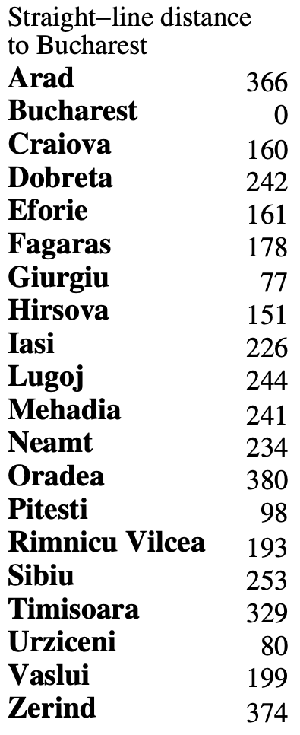
Question 1 – Greedy Best-first Search
Visited list
Connections
A
S
T
/ : A
A : S
A : T
A : Z
Z
F
R
S : F
S : R
S : O
F : B
O
B
:
:
:
:
:
:
:
:
Selected Path
A
S
F
B
Priority Queue
0
329
374
380
B
T
Z
O

Slide 27
Question 1 – A* Search
1
Time Complexity
O(b^{d})
10
Space Complexity
O(b^{d})
11
17
15
Complete
Ordered by path cost + heuristic
2
3
4
Optimal
Find goal state on expansion
5
3
6
Implementation
Datatype
19
11
12
16
Priority Queue
List
5
6
7
8
Visited list (Expansion)
List
Connections
Dictionary
7
3
0
8
Priority Queue
29
31
37
39
7
6
5
8

Slide 28
Question 1 – A* Search
Visited list
Connections
A
S
R
/ : A
A : S
A : T
A : Z
P
F
B
S : R
S : F
S : O
R : P
R : C
P : B
:
:
:
:
:
:
Selected Path
A
S
R
P
B
Priority Queue
418
447
449
526
671
B
T
Z
C
O

Slide 29
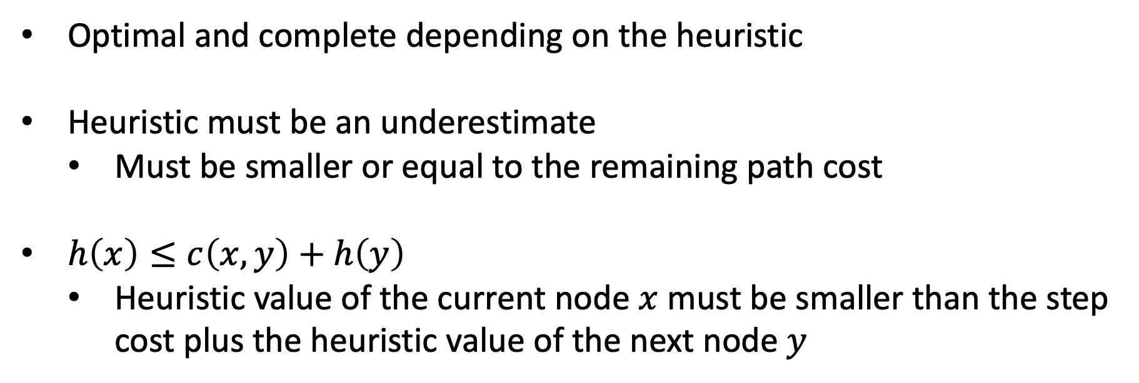
A* Search Optimality
Optimal and complete depending on the heuristic
Heuristic must be an underestimate
Must be smaller or equal to the remaining path cost
$h\left(x\right)≤c\left(x, y\right)+h\left(y\right)$
Heuristic value of the current node $x$ must be smaller than the step cost plus the heuristic value of the next node $y$

Slide 30
Notes
All python files for question 3 can be found at:
https://artint.info/AIPython/

